Slide 1

ITP-341
Final Project

Slide 2
Key Dates
Proposal
Due on Blackboard 11/15/16 at 11:59 pm
Project - Milestone
In-class – 11/29/16
Project - Code
Due on Blackboard – 12/11/16 at 11:59pm
Project - Individual App Demonstration
Sign up for a time – 12/12 and 12/13

Slide 3
Project Details
You will develop an app based on your own idea
Primary purpose of app must be to provide direct social benefit / social good
Social benefit could be to help a…
Small or large community
Socioeconomic group,
Underrepresented group
Geographic region
Etc.

Slide 4
Proposal
Motivation and need
What is the social need?
Why do want to address it?
How will you app help?
Include at least two reputable sources
App description
Key features / technology
Visual wireframes / prototypes

Slide 5
Milestone
Demonstrate key components
All UI elements
MVC

Slide 6
Project
Source code
User experience testing
Test 5 people with your app
Revised proposal (only if you changed the project from proposal)
In-person app demonstration

Slide 7
Real-World Examples

Slide 8
Crowdvoice
Citizen journalism platform focusing on human rights violations
Crowdsourced submissions from around the world
Adds news stories to provide context
App link
Source

Slide 9
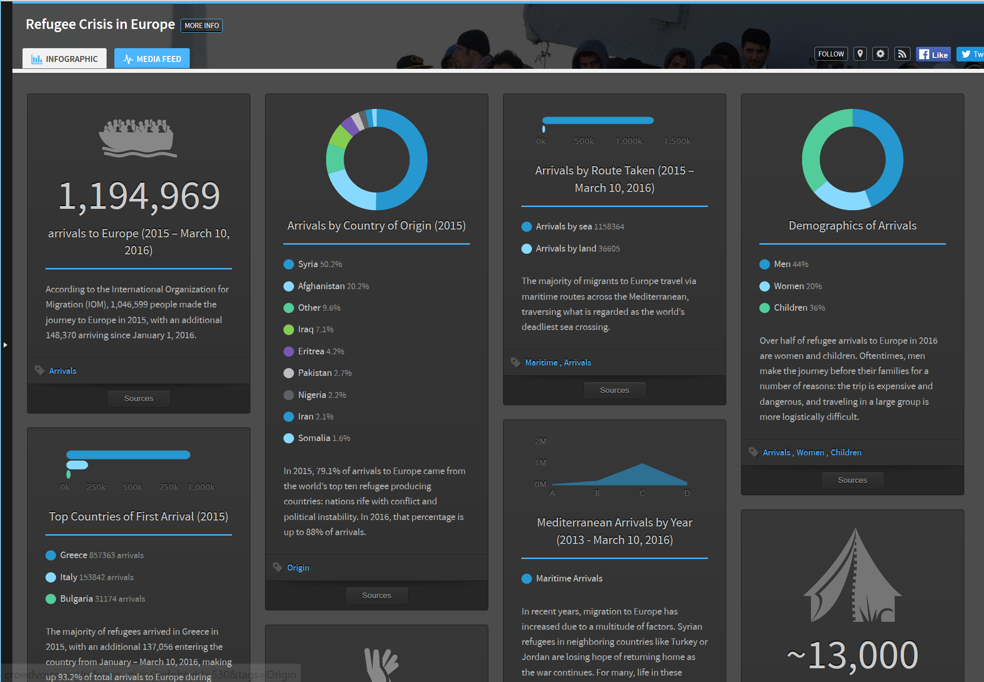
Crowdvoice
Citizen journalism platform focusing on human rights violations
Crowdsourced submissions from around the world
Adds news stories to provide context
App link
Source

Slide 10
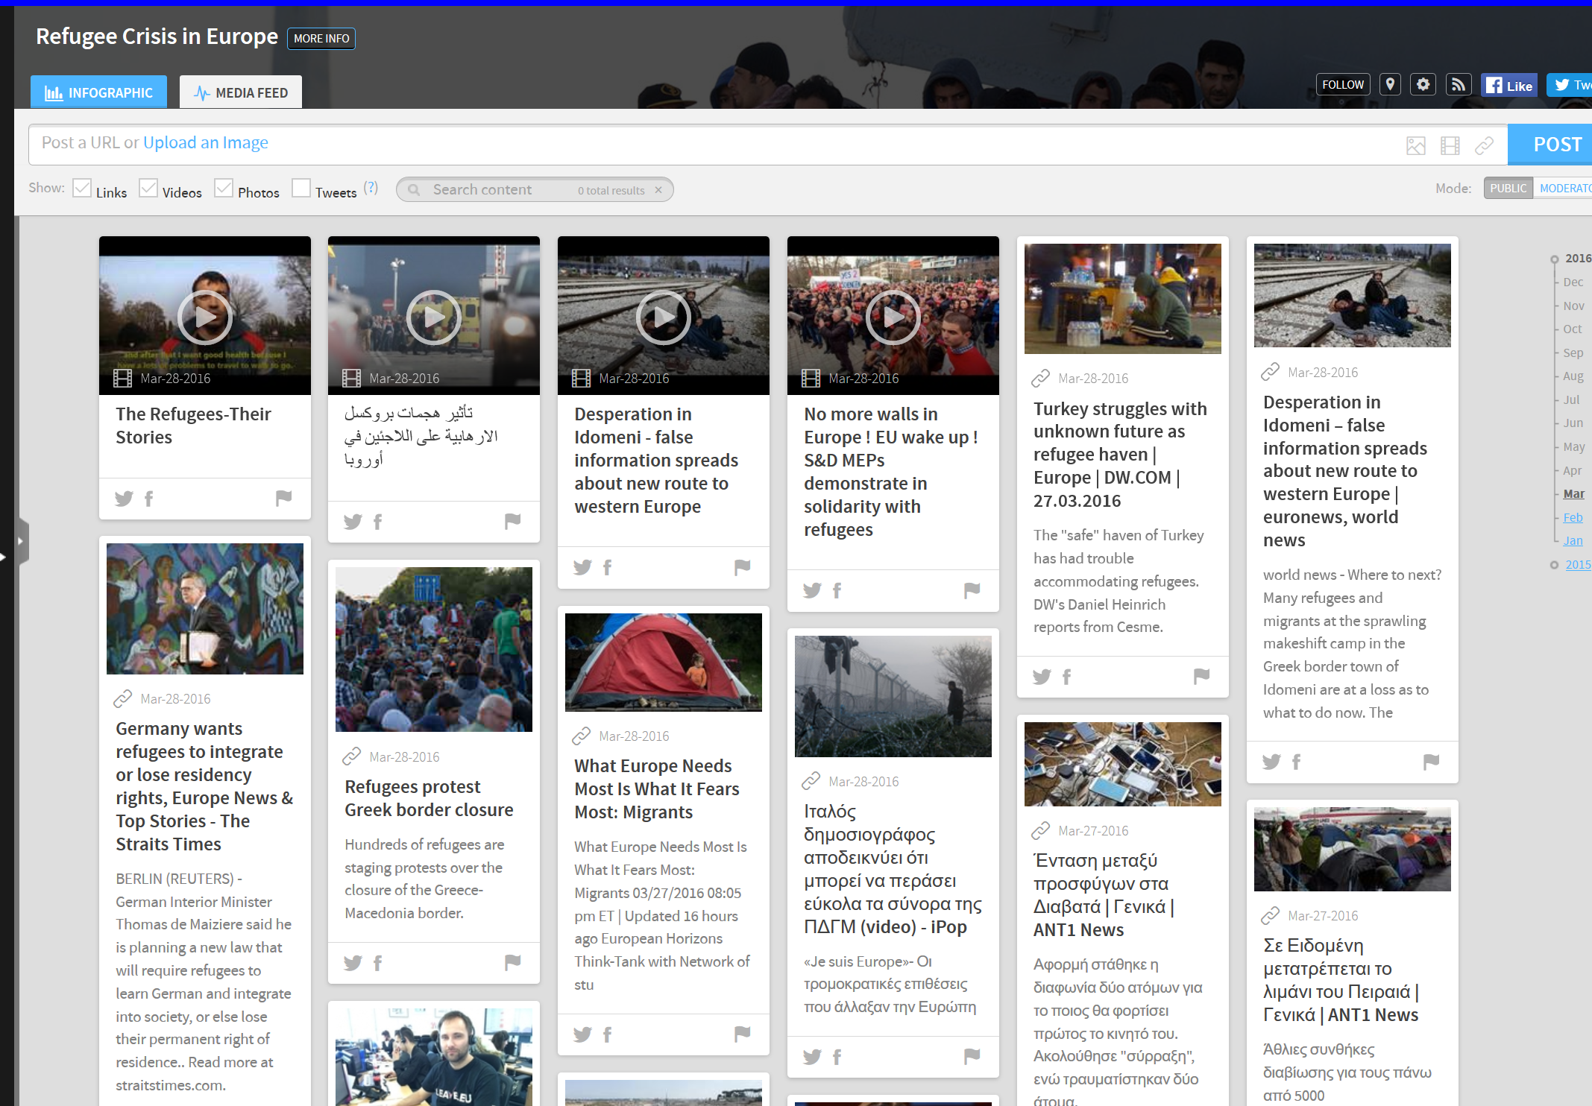
Crowdvoice
Citizen journalism platform focusing on human rights violations
Crowdsourced submissions from around the world
Adds news stories to provide context
App link
Source

Slide 11
Safe Water App
In 2014, the drinking water in Flint, MI started becoming contaminated
Aging infrastructure of water pipes have been leaking lead, exposing thousands to toxic poisoning
Currently there is a shortage of drinking water
Safe Water App provides a live of map of free water stations
App link
Source

Slide 12
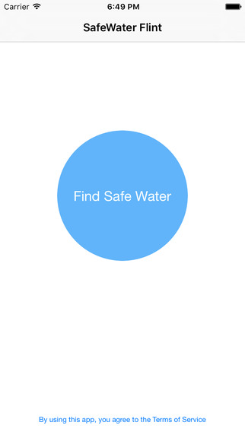
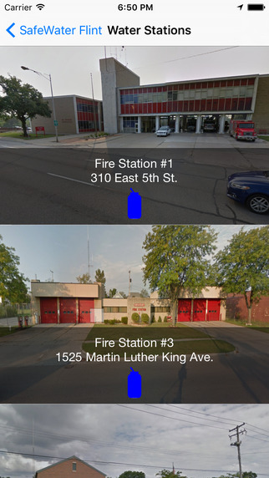
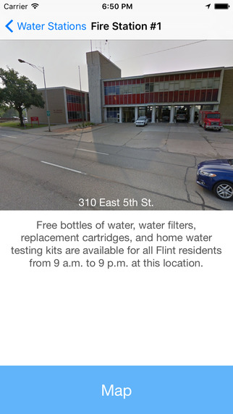
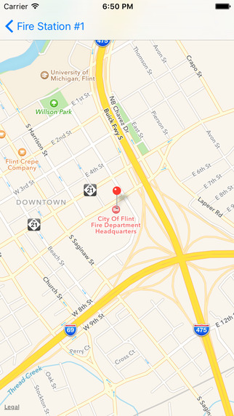
Safe Water App

Slide 13
Jornalero
Low-wage workers often may not be paid (wage theft)
They are also the most vulnerable if they lose income
App can track hours worked, unsafe work conditions, and employer information
Non-profit organization will contact employer about lost wages
Will seek legal case if necessary
Source

Slide 14
Examples from Other Students
The following are great examples of student projects
Note: not every project fulfilled all the requirements

Slide 15
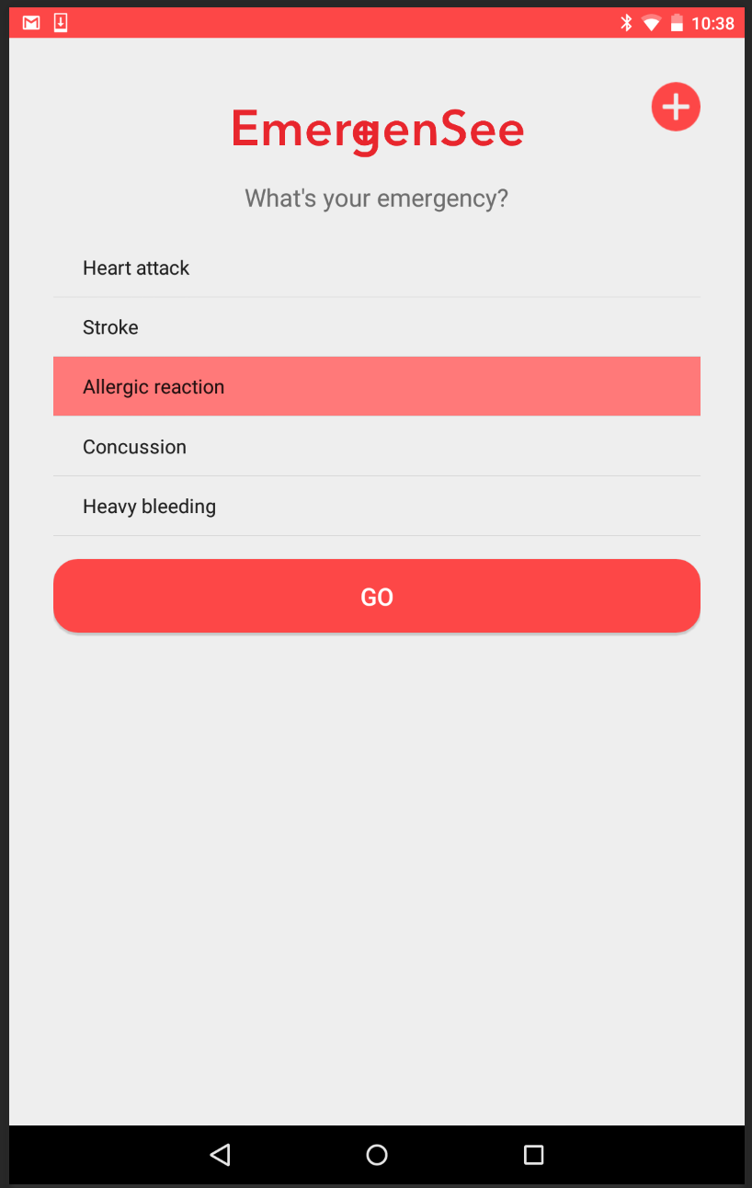
EmergenSee – Information on Health and Location of Emergency Rooms

Slide 16
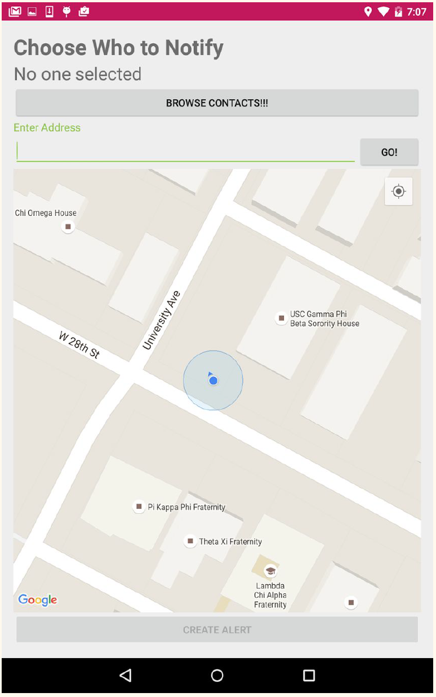
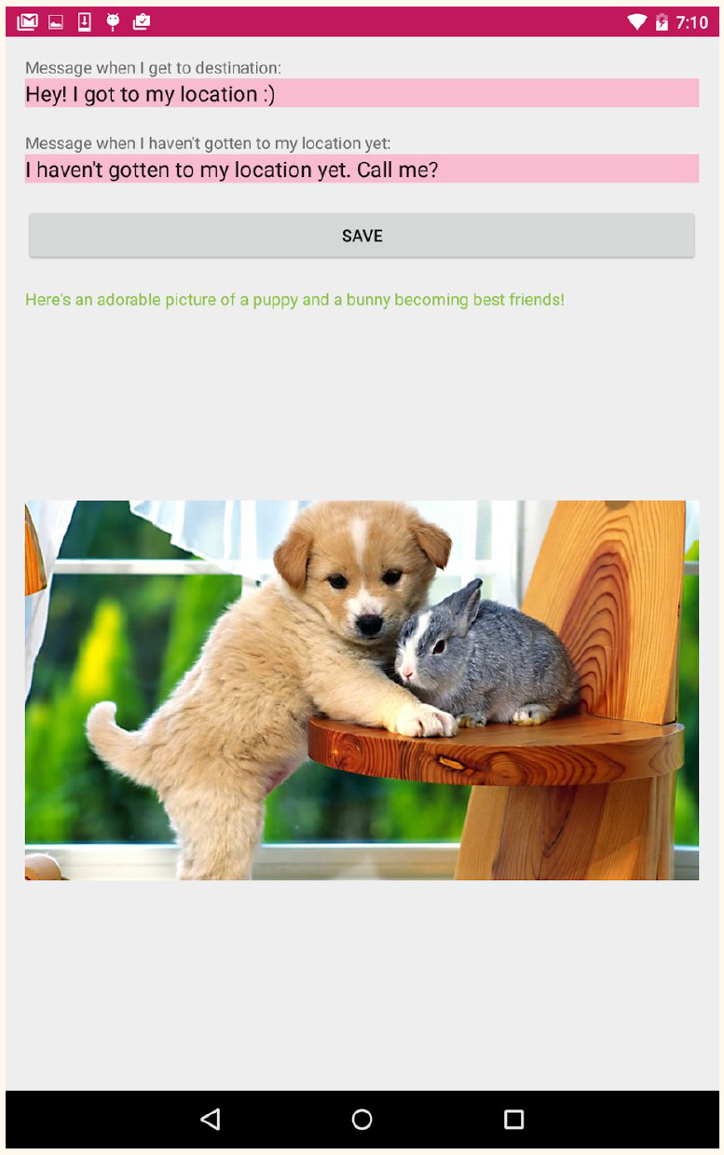
HomeSafe – Notify Friends When Walking Home

Slide 17
bLoodR – Blood Donor Registration

Slide 18
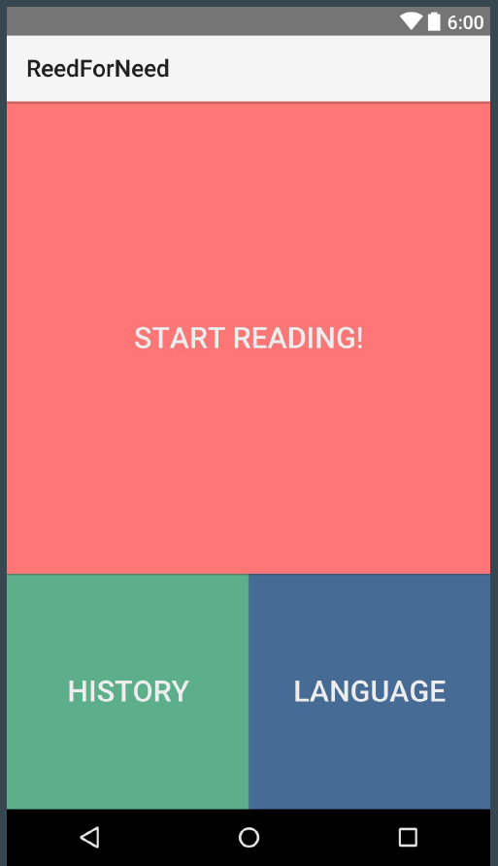
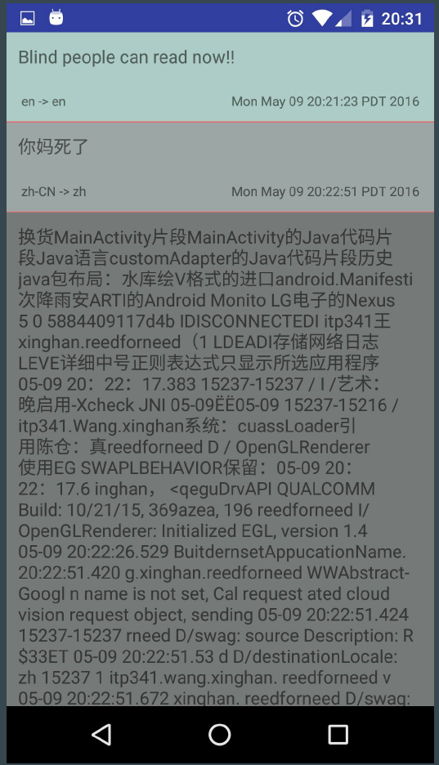
Read for Need – Translation for Users Who Are Visually Impaired
API: Image recognition and text translation

Slide 19
Furever Home – Database for Tracking Lost Pets

Slide 20
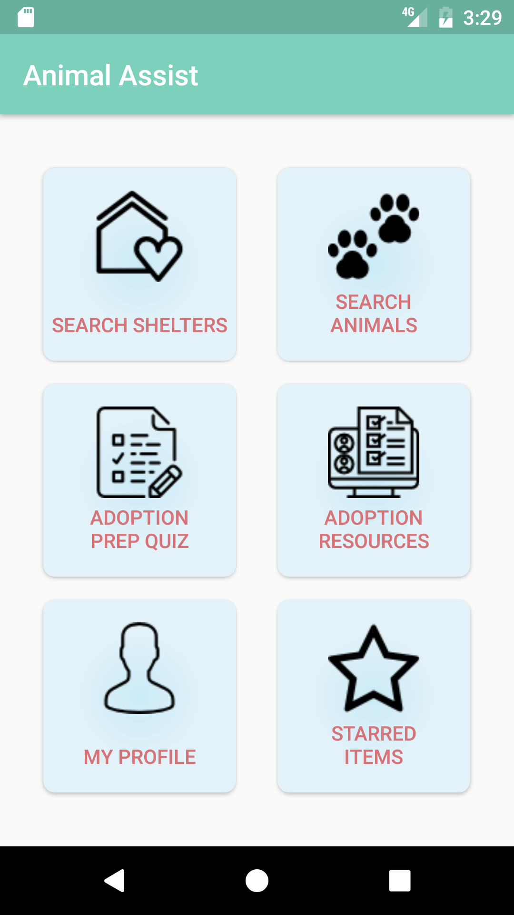
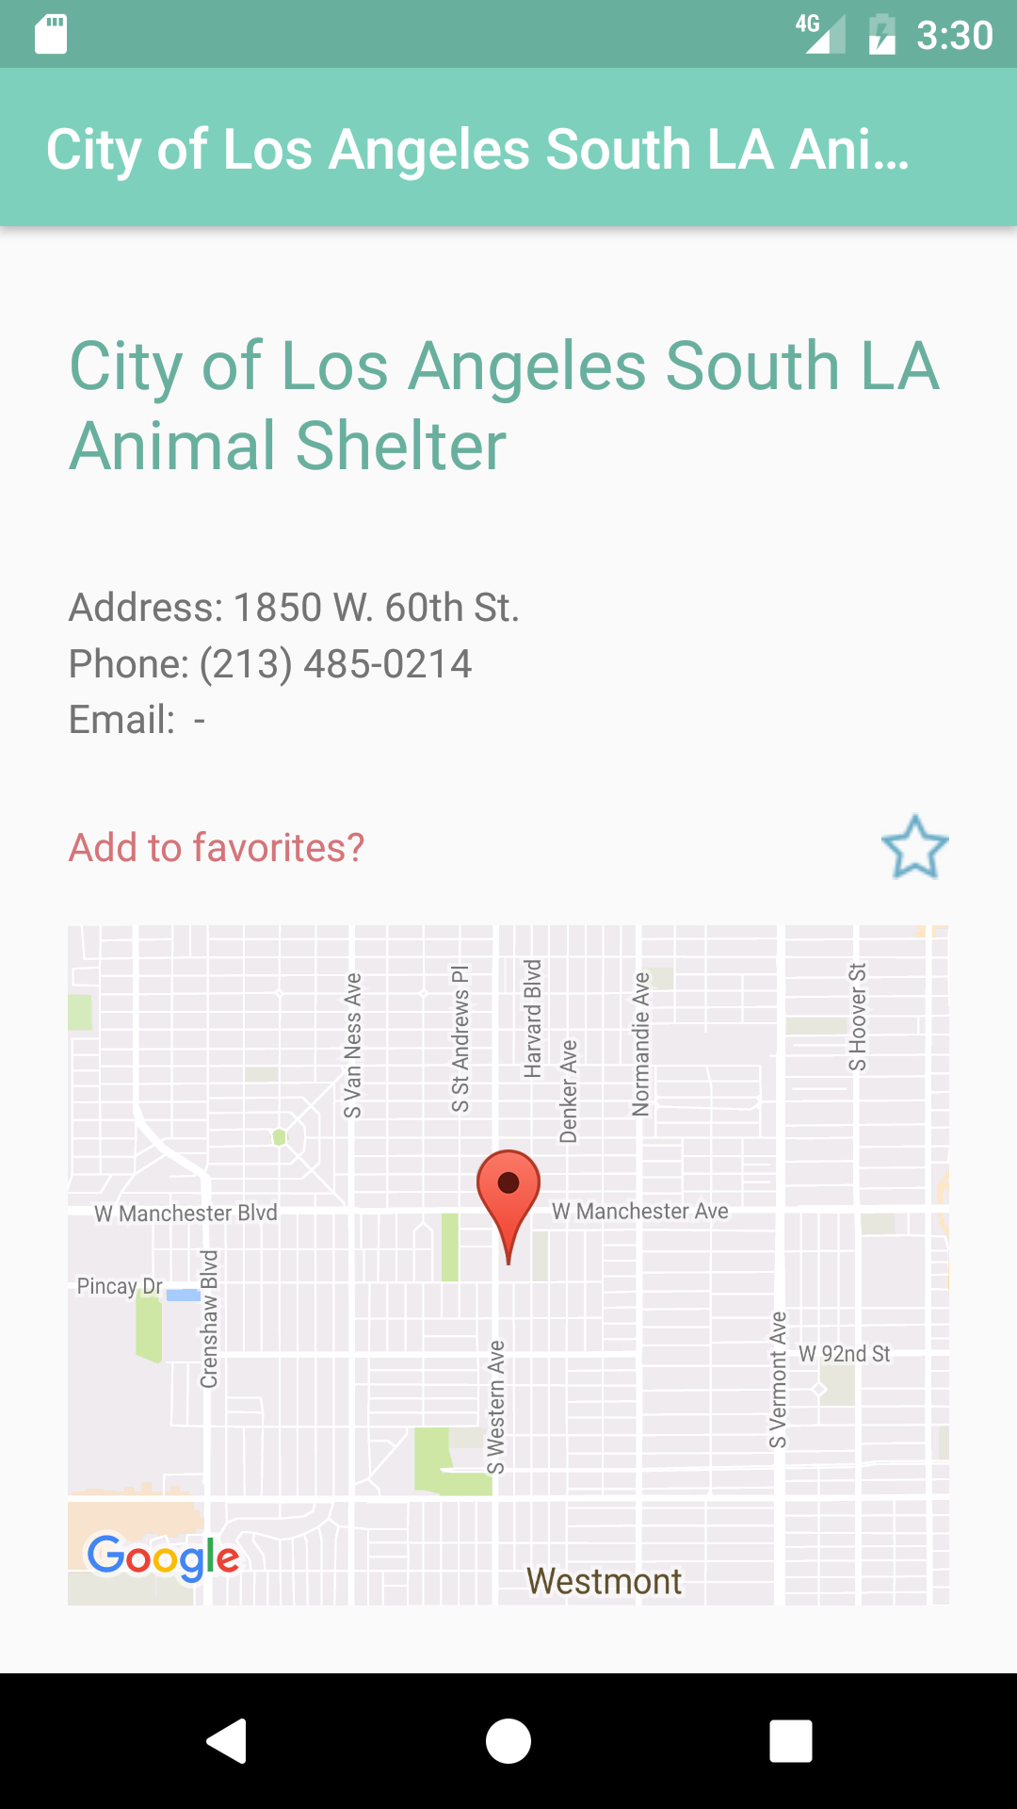
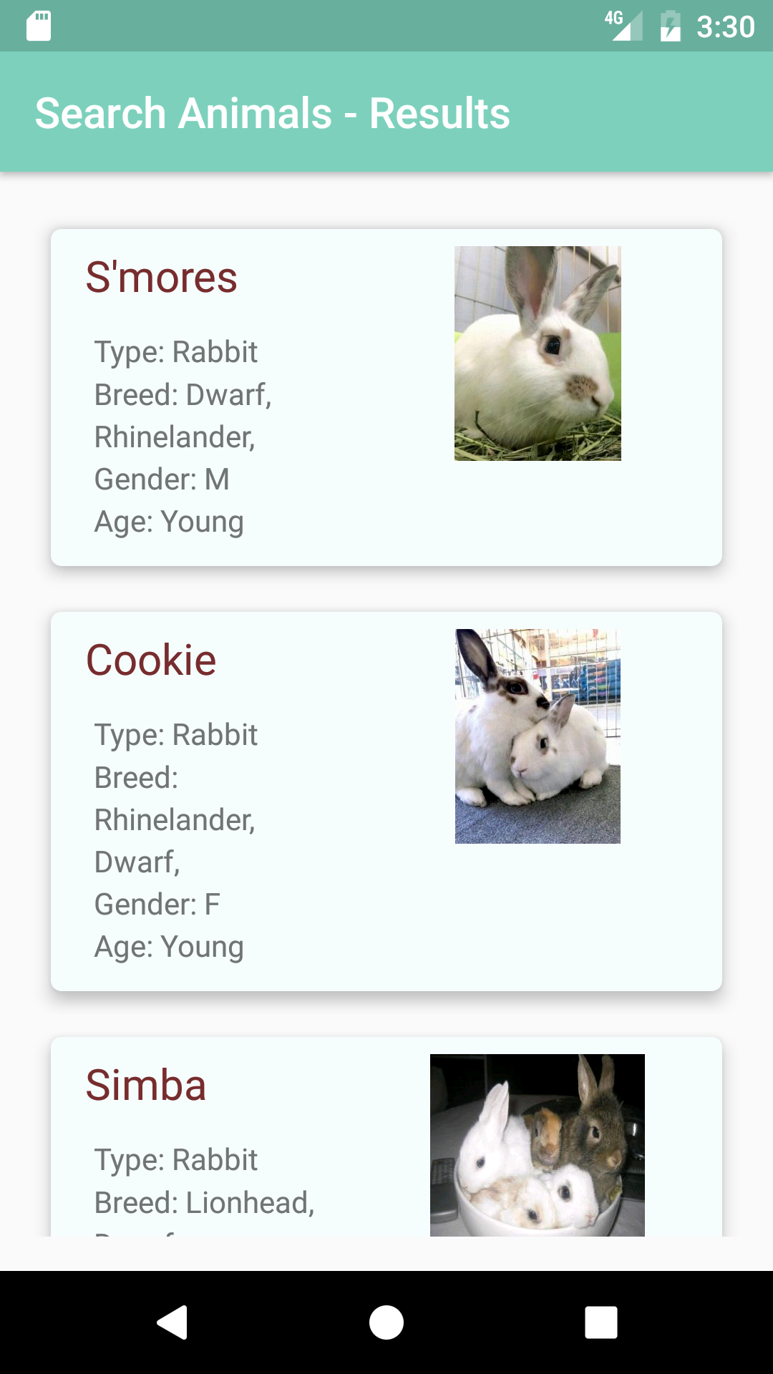

Slide 21
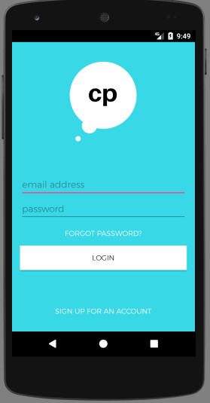

Slide 22
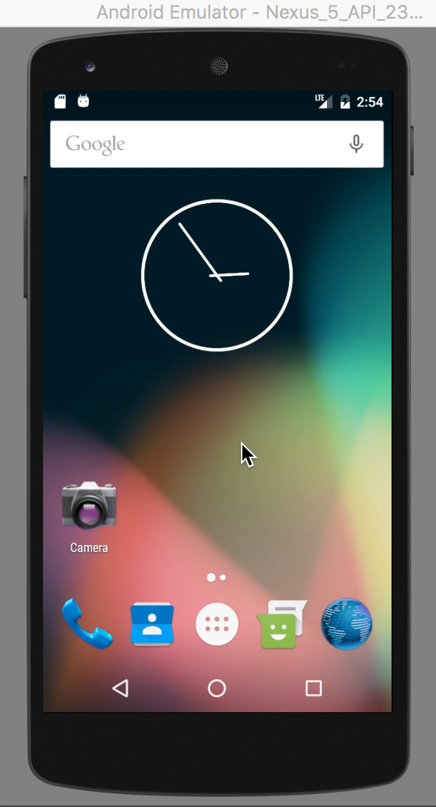
RepOn

Slide 23
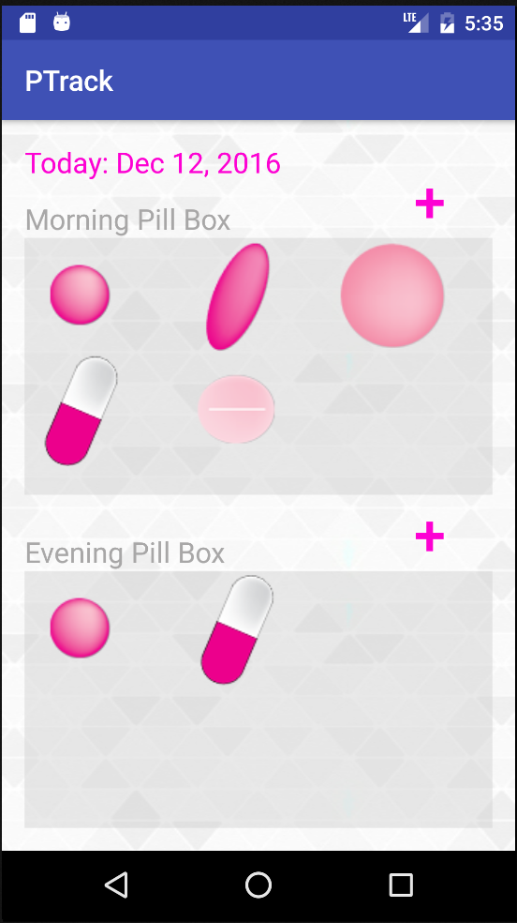
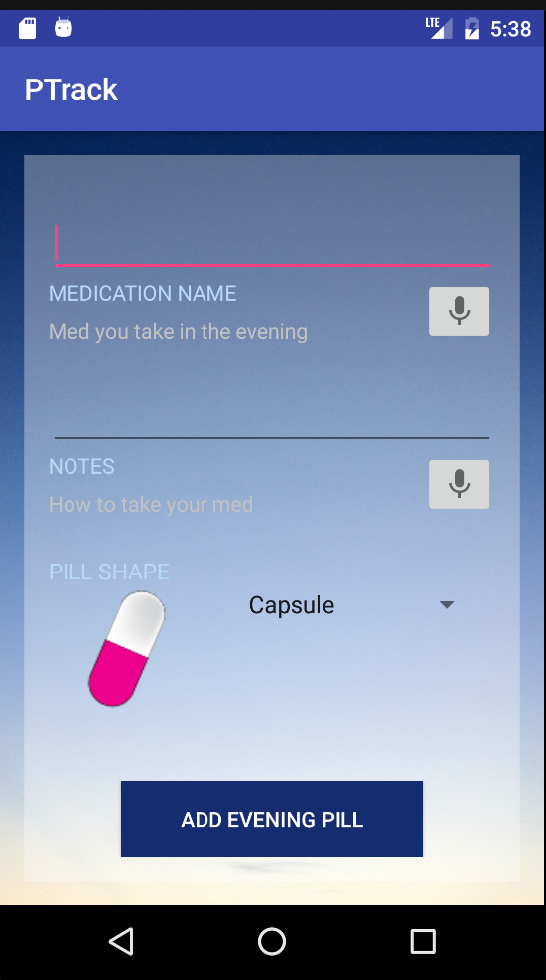
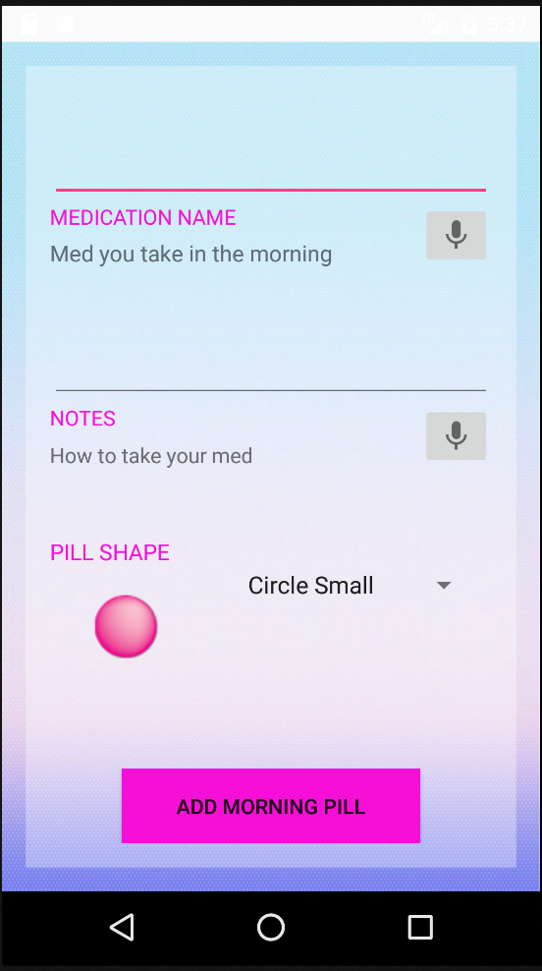
PillTrack

Slide 24
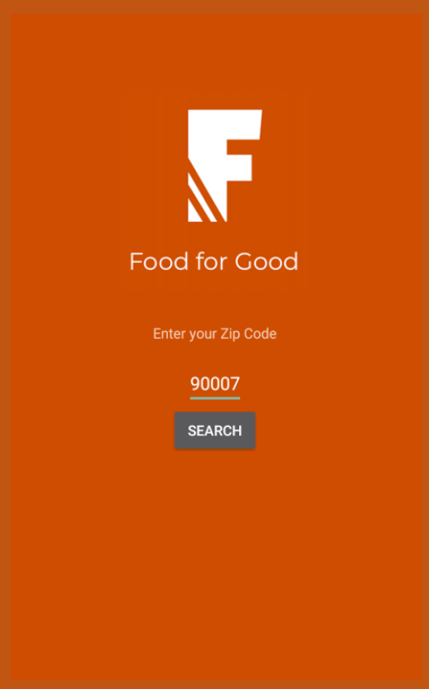
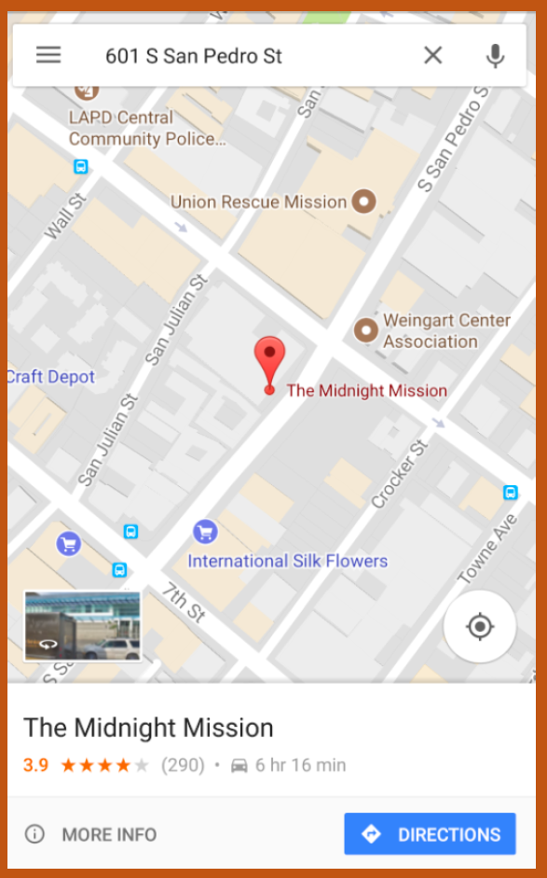

Slide 25
